Slide 1
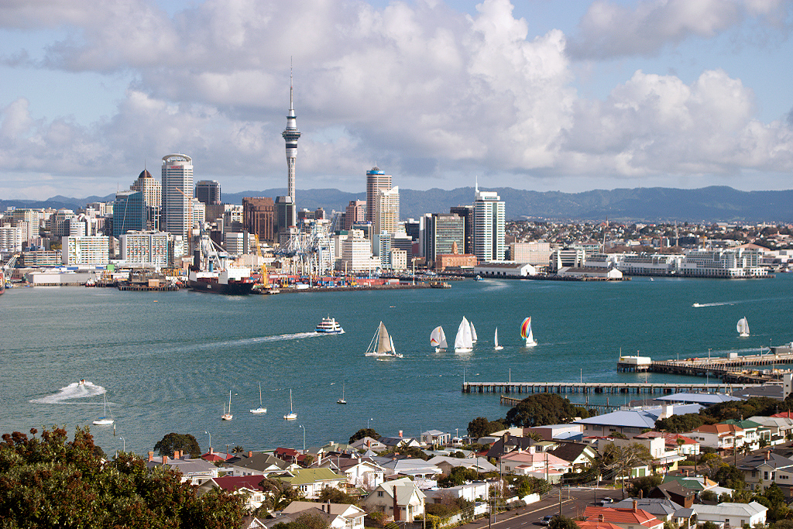
Tour Auckland
An Insider’s Guide to the City of Sails

Slide 2

New to Auckland?
Looking for something to do?
Want to be taken somewhere amazing?

Slide 3
What do you do?
Google “cool things to do in Auckland”?
You could go to that Restaurant your friend/Trip Advisor mentioned?
But then what?

Slide 4

[Logo comes here]

Slide 5
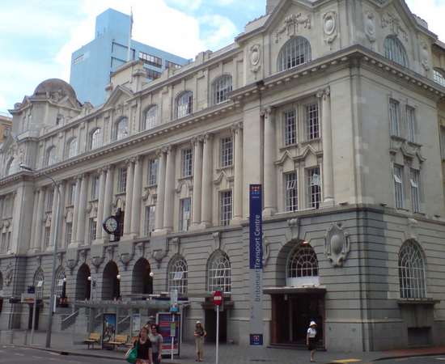
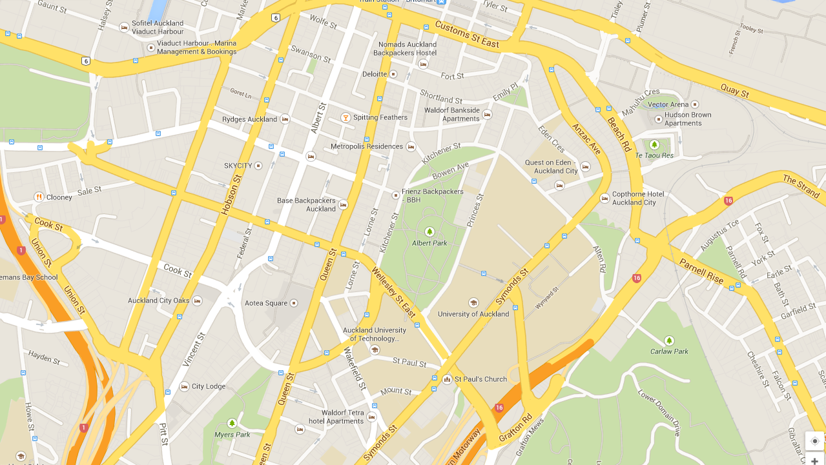
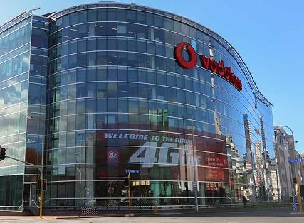
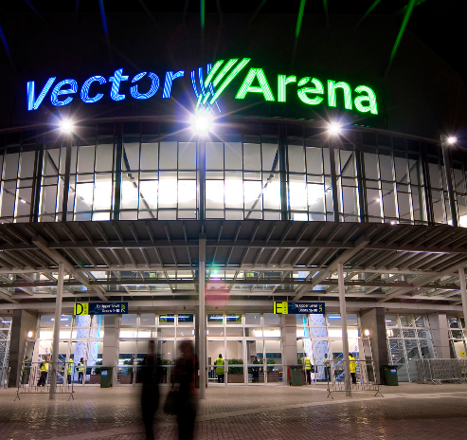
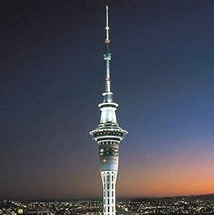
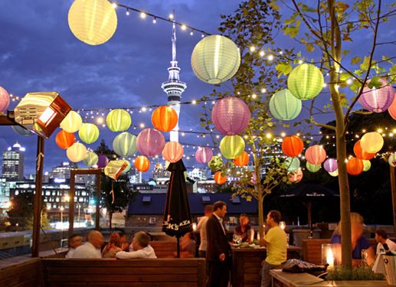
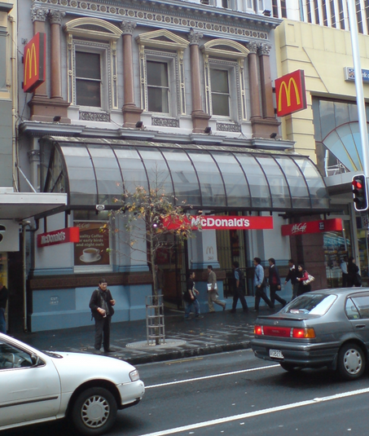
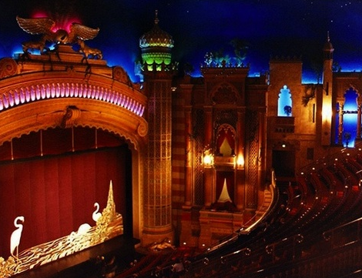
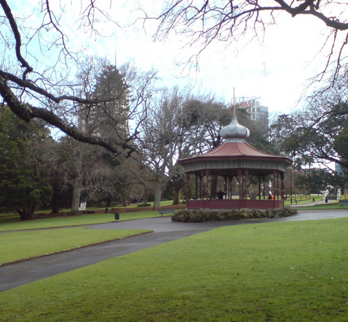
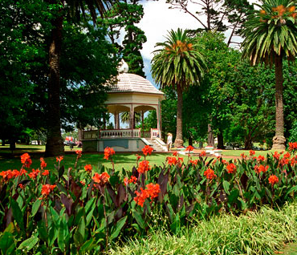
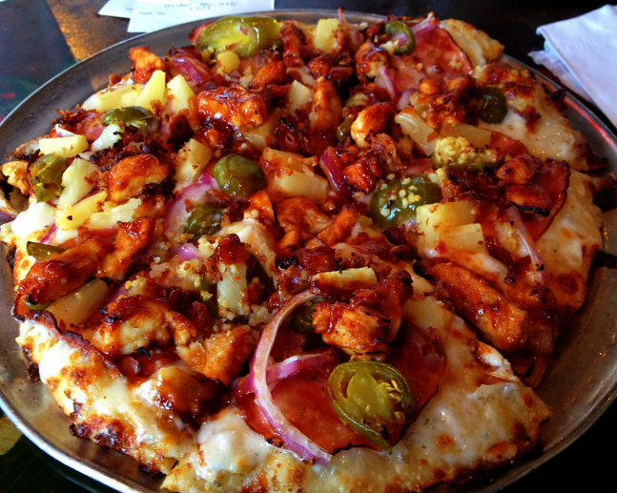
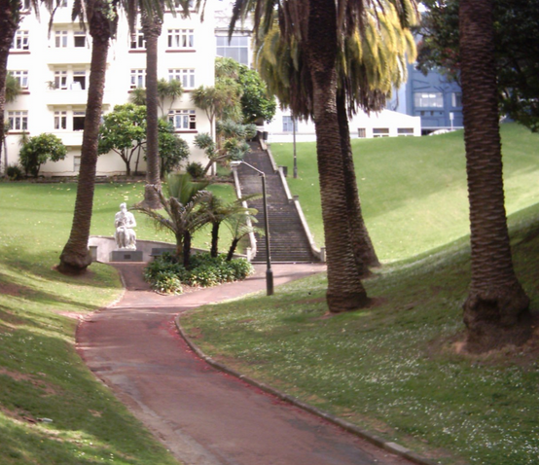

Slide 6
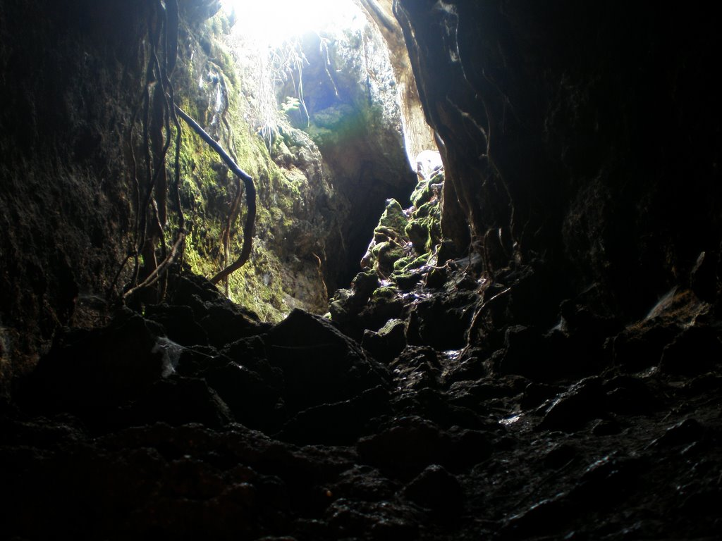
Find fun things to do in seconds

Slide 7
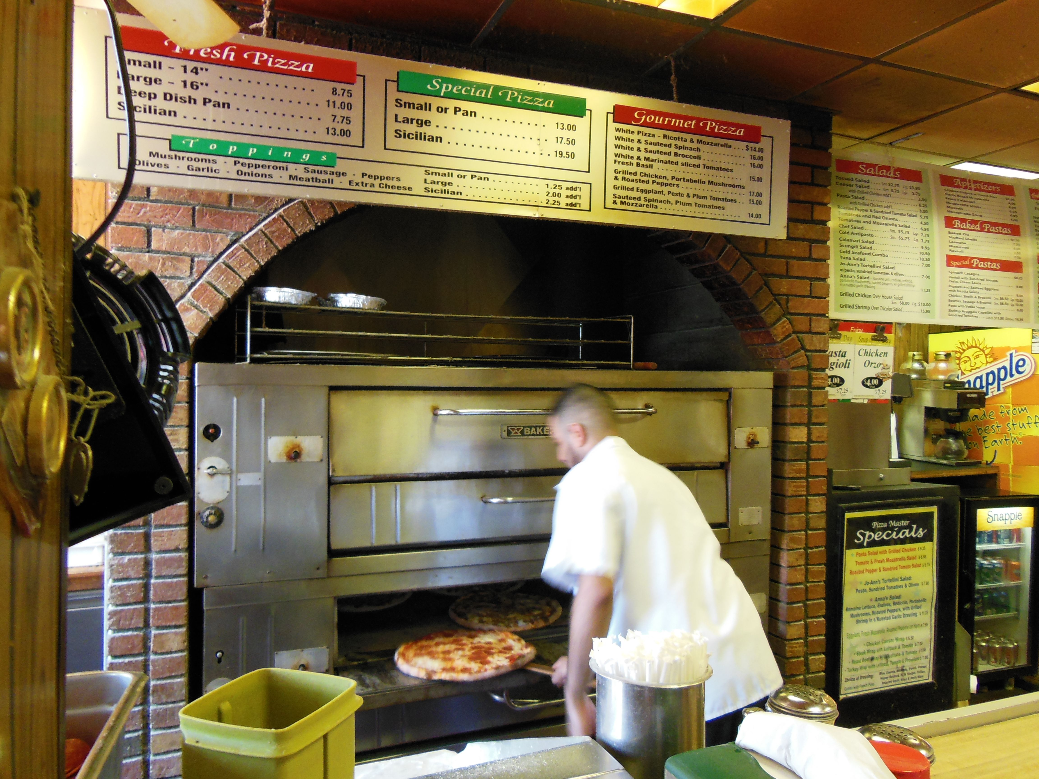
Upload your favourite Local Places

Slide 8

User browses through uploaded photos on map, taps on a photo which caught their attention – This brings them to a screen containing location background, user comments, public transport information and number of votes.

Slide 9
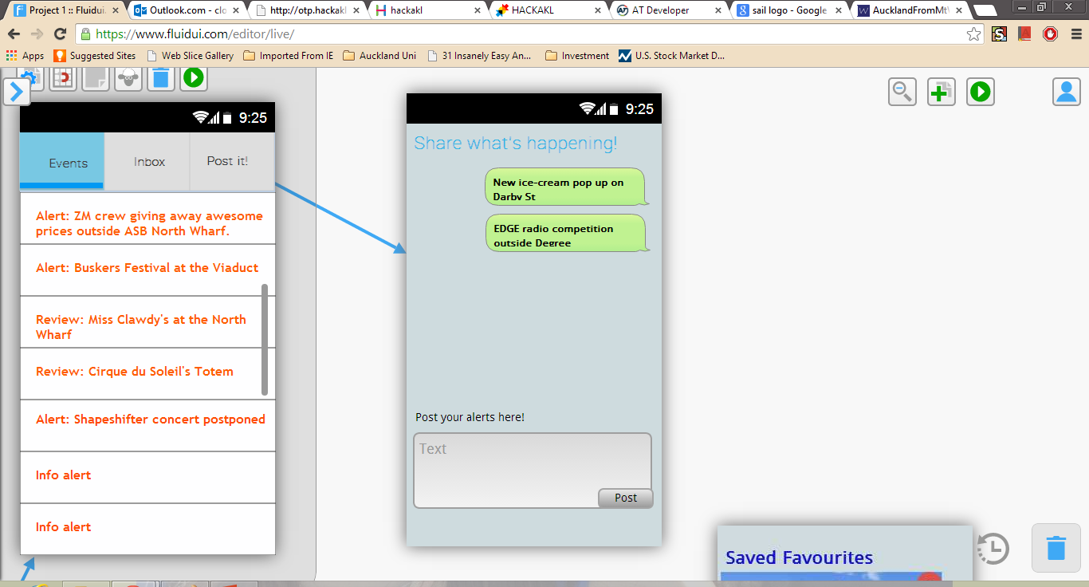
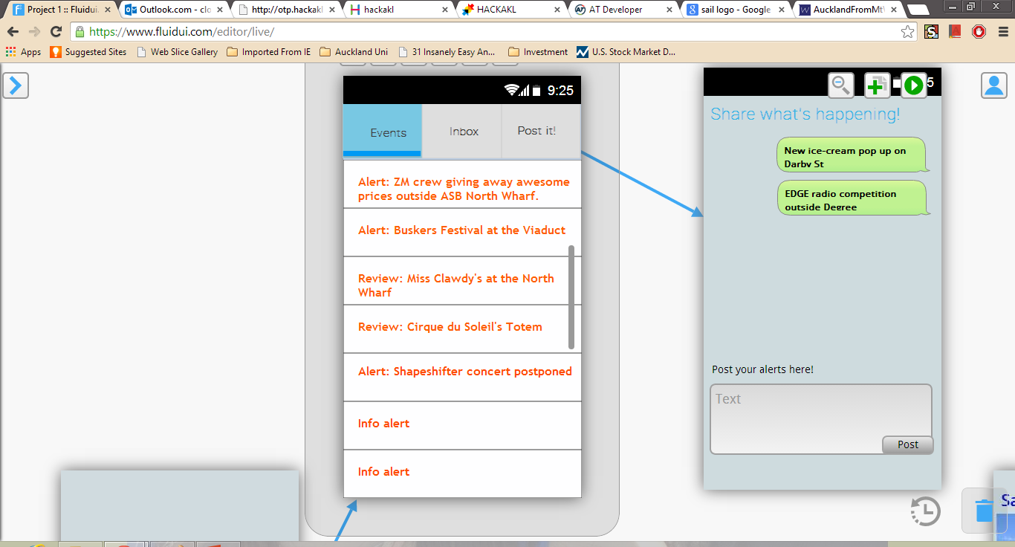
User contributions creates content of alerts for other users seeking activities for the day – refreshed by the minute and moderated.

Slide 10
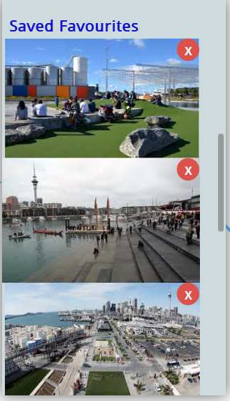
ALLOWS you to Save your favourite photos or bookmarked attractions and public transport information

Slide 11
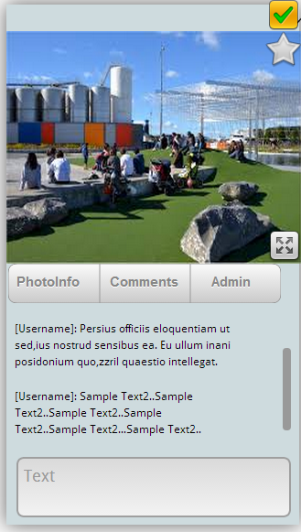
Allows users to vote and save as favourite. 1. Photoinfo→ general background of location, when it is uploaded and by whom (username) 2. Comments→ limited to 120characters max (reduce clutter). aims to promote feedbacks/suggestions. 3. Admin → allows users to flag inappropriate photos and/or comments.

Slide 12
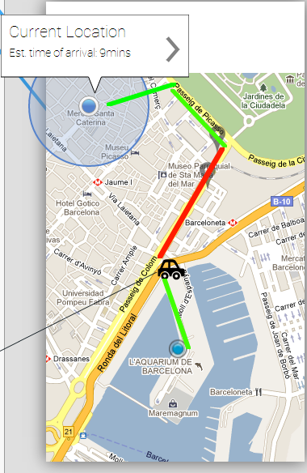
Navigator shows them the route (incl. walk path in green, bus route in red) from their current location, Est time of arrival and bus info in real time.

Slide 13
Incentives? 1. “karma” – ie. Reddit. 2. expert navigators helping first timers and explorers – and getting rewarded. 3. understanding of landmarks and attractions around Auckland enables new visitors to be more street smart, and cutting down cost and time of travel. 4. most have great photos of the city – no where else to share other than facebook or friends/family.

